Slide 1
FIND BOOK
Presented By: VISHNU K V

Slide 2
Problem Statement
The system provides users to add their details and also add the details of the books they posses.
Users can search the details of people who have a specific book or who like a specific category with them and view their details by providing book name or category.

Slide 3
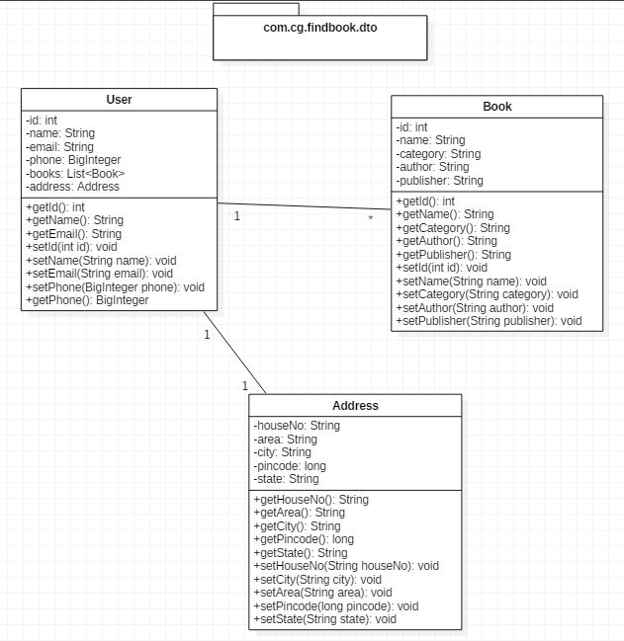
DTO Classes:

Slide 4
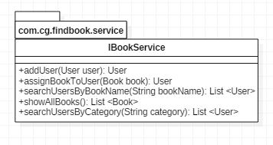
Service:

Slide 5
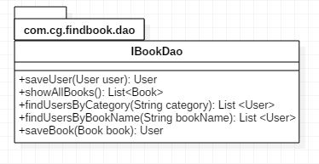
DAO

Slide 6
THANK YOU

